Slide 1
Let us entertain you
A few glimpses of British culture

Slide 2
Video: Dominic Sandbrook about Britishness
What is Britishness? How would you define this word?
Listen to the audio files and try to guess what they refer to.

Slide 3
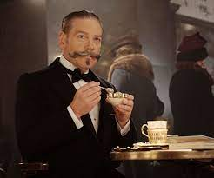

Slide 4
Let us entertain you (video)
A few questions about the video: https://www.youtube.com/watch?v=iiq28qwJtS0&t=495s
What was the situation of the English city Birmingham during the Victorian period? How did it evolve?
Who was Tony Iommi? What did he decide in 1965?
What is the link between Heavy metal and the industrial past of England? What information do you get about this new style of music?

